Slide 1
Red-Wine Linear regression
Gyurkovics Jonatán

Slide 2
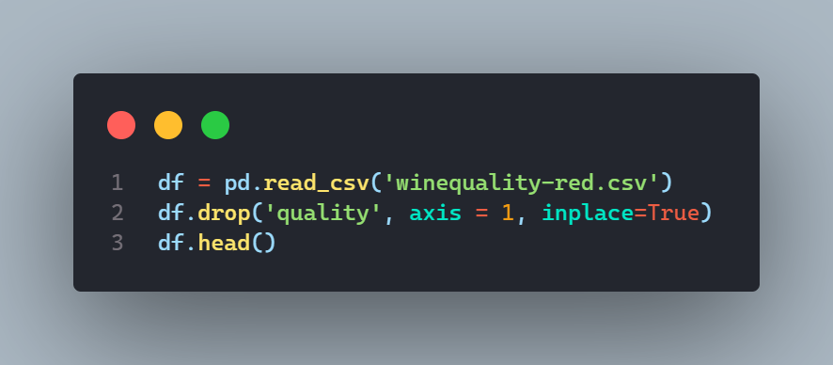
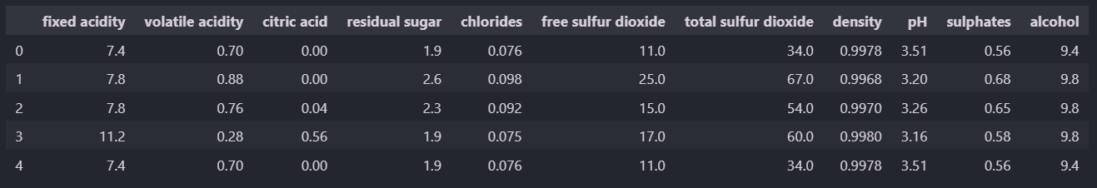
Dataframe

Slide 3
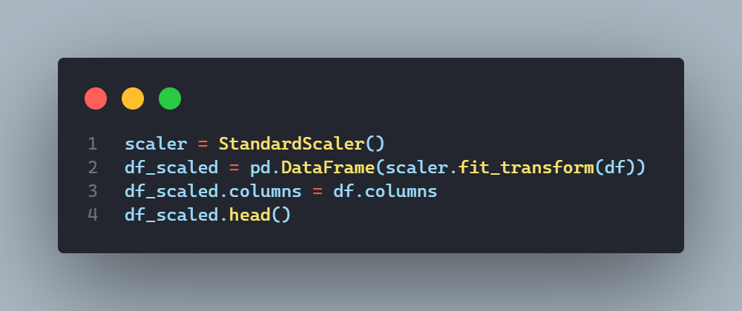
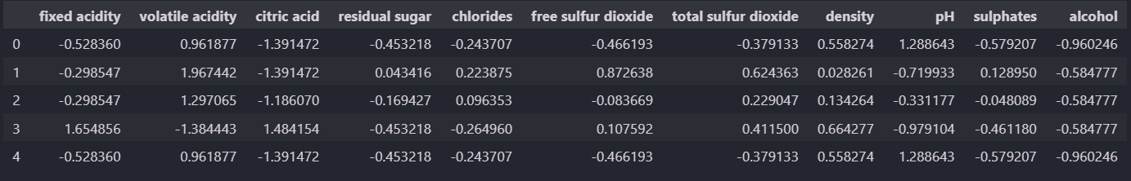
Scaling

Slide 4
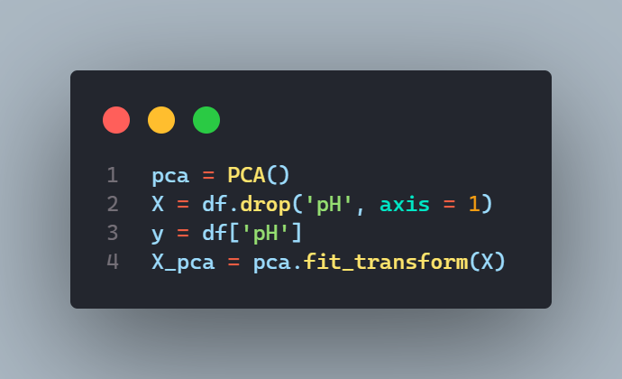
Principal Component Analysis

Slide 5
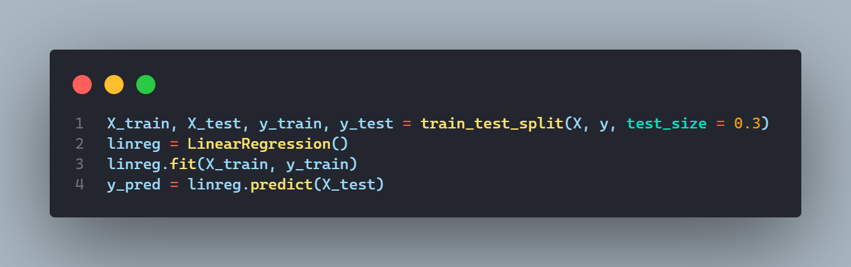
Linear regression

Slide 6
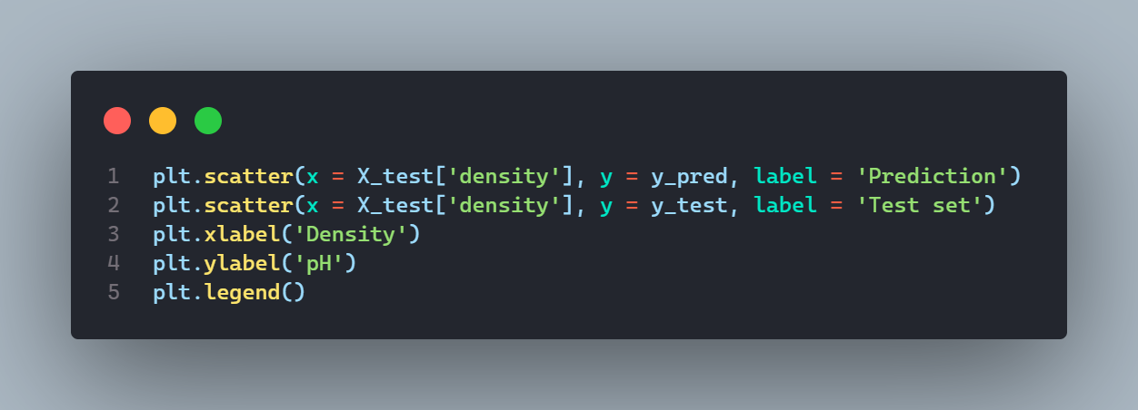
Plotting

Slide 7
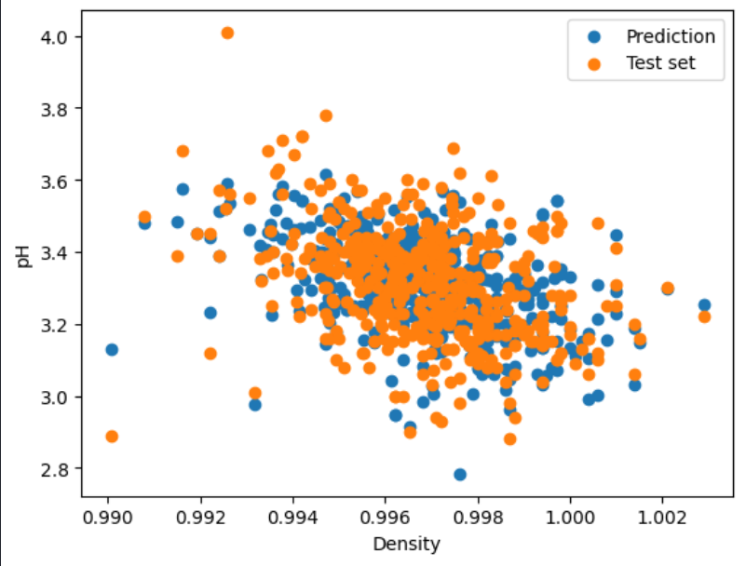
Result:

Slide 8
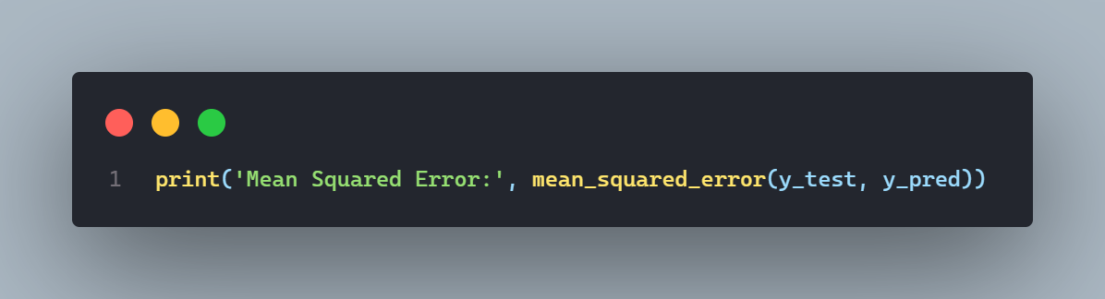
Mean Squared Error:
Result: 0.007148807558197606

Slide 9
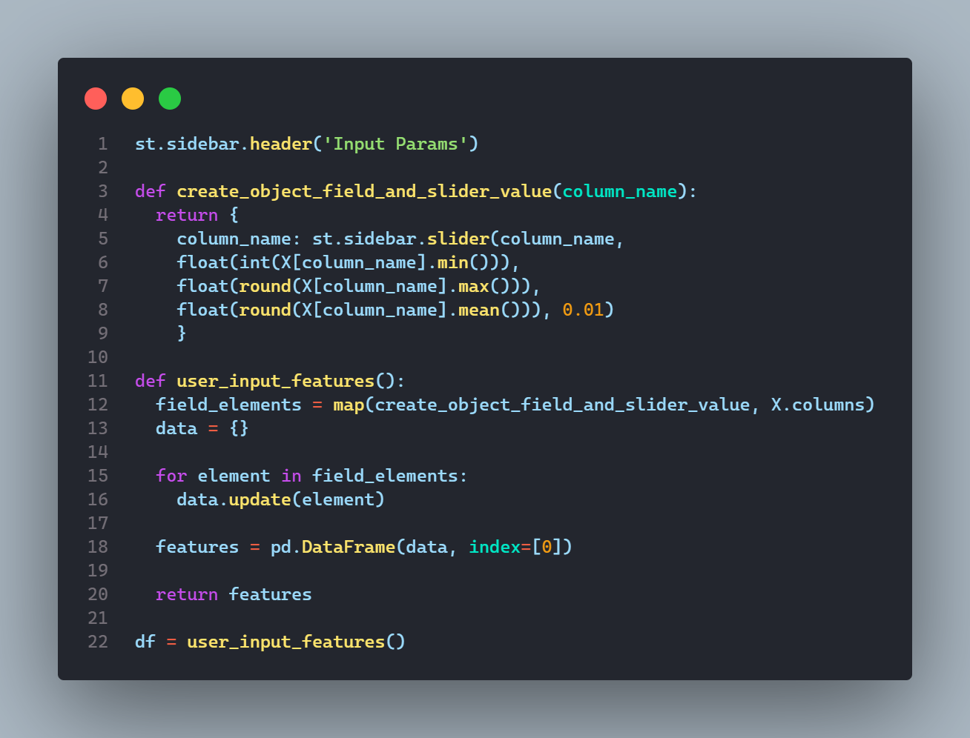
Streamlit slider

Slide 10
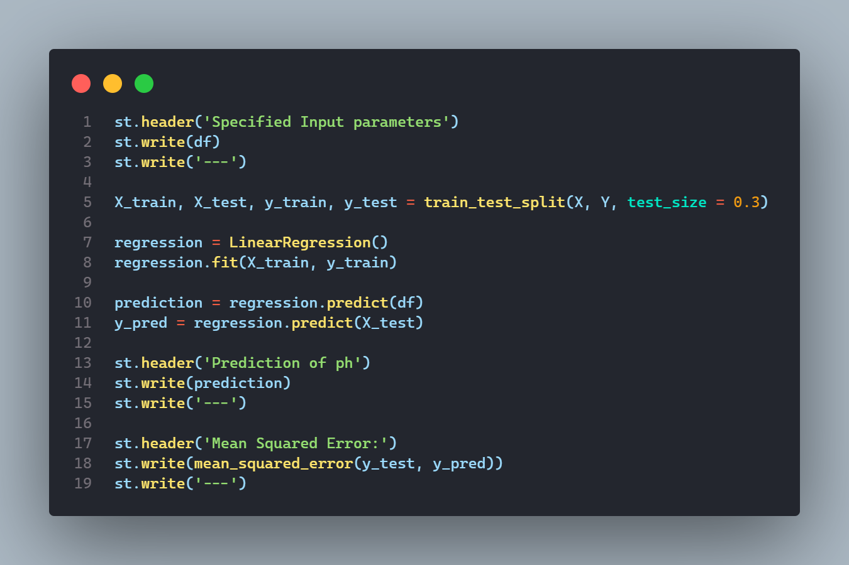
Streamlit: Prediction and MSE

Slide 11
Köszönöm a figyelmet!
Források:
Dataset: Red Wine
Linear Regression: bevadat gyakorlatok
Streamlit: Build 12 Data Science Apps with Python and Streamlit - Full Course

